Slide 1
The Cellular Concept-
System Design Fundamentals

Slide 2
Outline
Cellular Concept
Frequency Reuse
Handoff Strategies
Interference and System Capacity
Channel assignment
Trunking and Grade of Service
Improving Coverage and Capacity in Cellular Systems

Slide 3
Cellular Concept
The total coverage area of cellular radio systems is divided into smaller geographic area called cell
The base station for that cell is allocated a number of radio channel to be used only within that cell
Hexagon is a better choice for cell because they can cover the geographic region with the fewest number of cells rather than square or triangle.
Hexagon also closely approximates a circular radiation pattern which would occur for an Omnidirectional antenna.

Slide 4
Frequency Reuse
Base stations in adjacent cells are assigned channel groups which is completely different than neighboring cells
The base station antennas are designed to achieve the desired coverage within a particular cell
By limiting the coverage area within the boundaries of a cell, the same group of channels may be used to cover different cell that are separated from one another by keeping the interference level within tolerable range. This is called Frequency Reuse

Slide 5
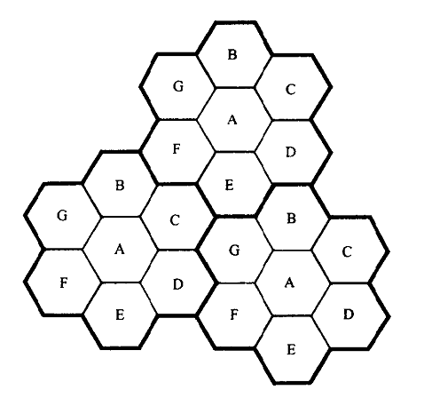
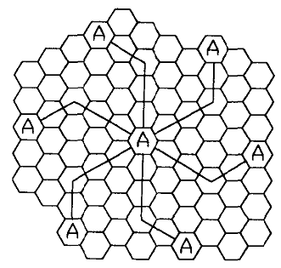
Frequency Reuse (cont’d)
The N cells which collectively use the complete set of available frequencies is called a Cluster.
N = 19. i=3, j=2.

Slide 6
Frequency Reuse (cont’d)
Consider the following
  k = The group of channels allocated to each cell
  N = Number of cells in a cluster
Then Total number of available radio channels, S = kN
Again if a cluster is M times repeated
Then Total number of duplex channels, C = MkN = MS
Cluster size is represented by N and is typically 3, 7, 12 or 13 based on the formula N = i² + ij + j²

Slide 7
Example #1
A 30 MHz spectrum is allocated to a wireless system which uses two 25 KHz simplex channels to provide full duplex voice and control channels. Compute the number of channels available per cell if the that system uses 7-cell reuse. If 1 MHz of the allocated spectrum is dedicated to control channels, determine an equitable distribution of control channels and voice channels in each cell of that system
Answer:
Total bandwidth = 30 MHz
Channel bandwidth = 25 KHz X 2 simplex channels = 50 KHz/duplex channels
Total available channels = 30,000/50 = 600 Channels = S
As N = 7, total number of channels available per cell,
k = S/N = 600/7 ≈ 85 Channels

Slide 8
Example #1 (cont’d)
A 1 MHz spectrum for control channels implies that there are 1000/50 = 20 Control Channels out of the 600 channels available.
To evenly distribute the control and voice channels, simply allocate the same number of voice channels in each cell wherever possible.
For N = 7, total number of voice channels = (600-20) / 7
= 82 Voice Channels
4 cells with 3 control channels and 82 voice channels
3 cells with 2 control channels and 83 voice channels

Slide 9
Channel Assignment strategies
Fixed Channel Allocation (FCA)
  fixed number of channels are permanently allocated to each cell.
  If all the channels of that cell are occupied, then any new call attempt will be blocked
Dynamic Channel Allocation (DCA)
  Channels are not permanently allocated to the cell
  One cell can borrow channels from the neighboring cell if needed.
  MSC requires channel occupancy, traffic distribution and Radio Signal Strength Indications (RSSI) data for managing dynamic allocation of channels

Slide 10
Handoff Strategies
When a mobile moves into a different cell while a conversion is in progress, the MSC automatically transfers the call to a new channel belonging to the new base station. This is called handoff.
A slightly stronger signal level than the minimum acceptable signal level (usually -90 dBm and -100 dBm) is used as a threshold at which handoff is made.
Definitions of terms like Hard handoff, Soft Handoff, Locator Receiver, Mobile Assisted Handoff (MAHO), Intersystem Handoff

Slide 11
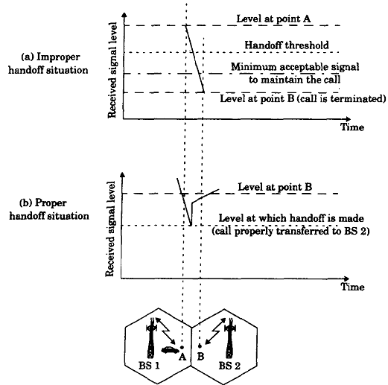
Handoff Strategies (cont’d)

Slide 12
Prioritizing Handoffs
Guard channel concept
  A fraction of the total available channels in a cell is reserved for handoff requests, known as guard channels
  It reduces the total carried traffic but it also reduces forced terminations of the ongoing calls that will irritate the users.

Slide 13
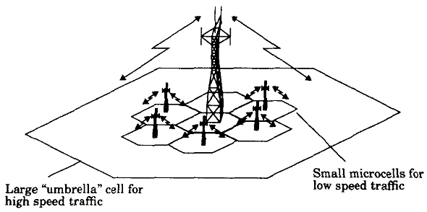
Practical Handoff Considerations
High speed vehicles pass through the coverage region within a matter of seconds whereas pedestrian users may never need a handoff during a call
Umbrella Cell approach
Cell dragging

Slide 14
Interference and System Capacity
Interference may happen because of another mobile in the same cell, a call progress in the neighboring cell, other base station operating in the same frequency band, or from any other noncellular system
Interference is recognized as a major bottleneck in increasing capacity and is often responsible for dropped calls
Co-channel interference → From the cell using same frequency
Adjacent Channel interference → From frequencies adjacent to the desired signal frequency

Slide 15
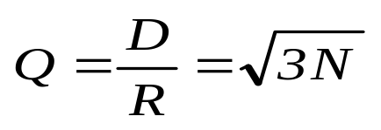
Co-channel interference
Unlike thermal noise which can be overcome by increasing the SNR, co-channel interference cannot be combated by increasing the carrier power. Rather it will increase the interference
To reduce co-channel interference, co-channel cells must be physically separated by a minimum distance to provide sufficient isolation due to propagation
Co-channel reuse ratio,
where R = Cell Radius
D = Distance between centers of nearest co-channel cells

Slide 16
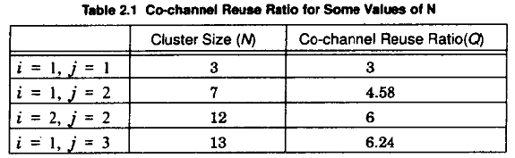
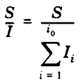
Co-channel interference
A small value of Q provides larger capacity since cluster size is small whereas a large value of Q improves quality as con-channel interference is reduced
Cluster Size,
N=i²+ij+j²
Let i₀ be the number of co-channel interfering cells.
Then the Signal-to-Interference (S/I or SIR) is
  where S is the desired power level and
  I_{i} is the interference power caused by ith
  co-channel base station

Slide 17
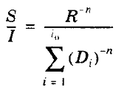

Co-channel interference
When the transmit power of each base station is equal and the path loss exponent (n) is same throughout the coverage area, S/I can be given as
Considering only the first layer of interfering cells, if all the interfering base stations are equidistant (D) from the desired base station, then
There are six co-channels cells in the first tier, so i₀=6

Slide 18
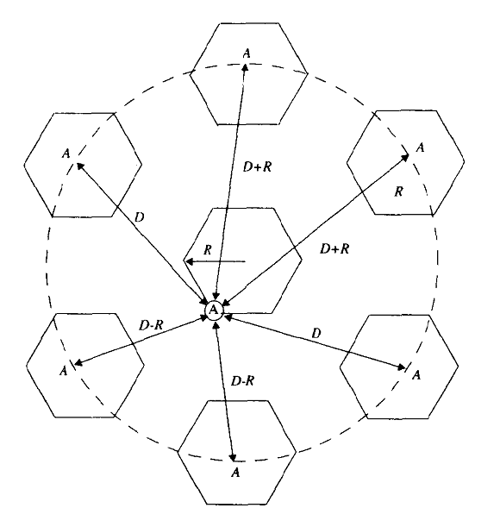


Illustration of first layer interfering cells

Slide 19
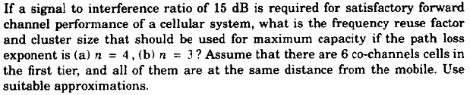
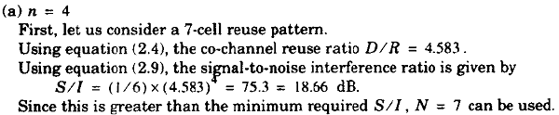
Example #2

Slide 20
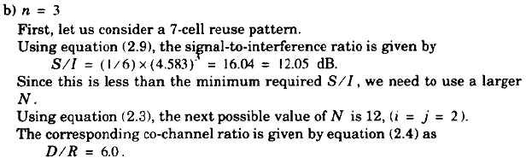

Example #2 (cont’d)

Slide 21
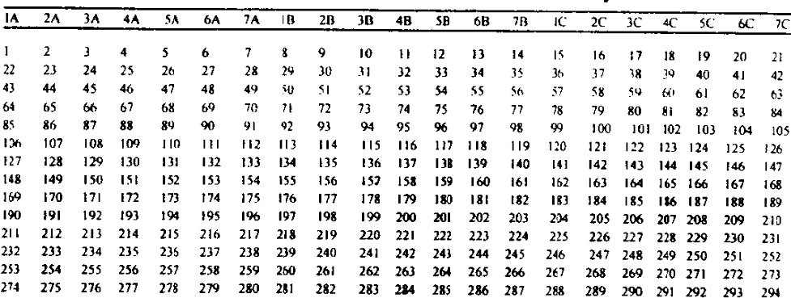
Adjacent Channel Interference
Channels are allocated such that the frequency separation between channels in a cell is maximized
By keeping the frequency separation between each channel in a cell as large as possible, the adjacent channel interference may be reduced considerably.

Slide 22
Power Reducing for Reducing Interference
The goal is to ensure that each mobile transmits the smallest power necessary to maintain a good quality link.
It will help to prolong the battery life
It will also dramatically reduce the Signal-to-Interference ratio

Slide 23
Reference
Wireless Communications: Principles and Practice – Theodore S. Rappaport
  E-Book, 1st Edition – Section 2.1 – 2.5, Page 25 - 44
  Paper book, 2nd Edition – Section 3.1 – 3.5, Page 57 - 77

